Slide 1

HEART DISEASE DIAGNOSTICS ANALYSIS
JATHIN REDDY JAIDI

Slide 2
Agenda
Introduction
Main KPIs
Details of data
About tools and work
Conclusion

Slide 3
Introduction
* The goal of this project is to analyze the heart disease occurrence, based on a combination of features that describes the heart disease.
* Health is real wealth in the pandemic time we all realized the brute effects of covid-19 on all irrespective of any status. You are required to analyze this health and medical data for better future preparation.
* A dataset is formed by taking into consideration some of the information of 303 individuals.

Slide 4

MAIN KPIs
Key Performance Indicator
Chest pain by age and gender
Average BP by age
Average age by gender
Maximum Heart rate by age and gender
Diabetes by gender
Peak Exercise ST

Slide 5
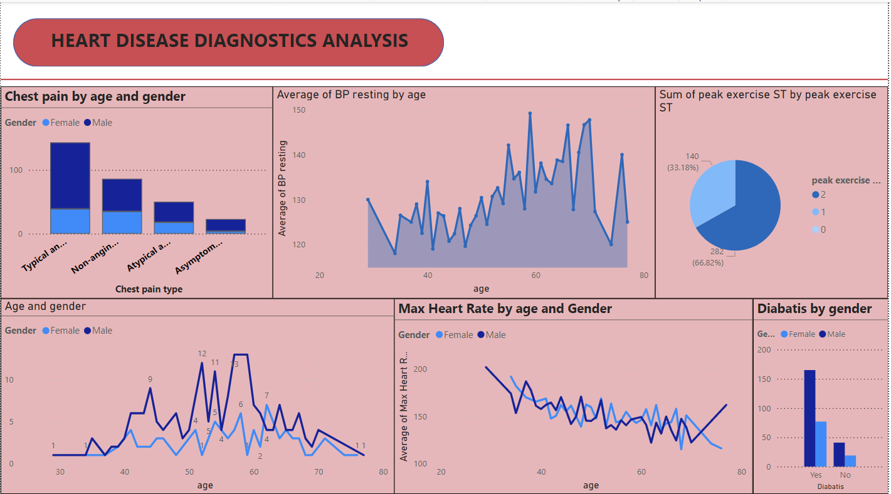


Primary goals
ANNUAL REVENUE GROWTH

Slide 6

Details of Data
Age : The person's age in years
Sex : The person's sex (1 = male, 0 = female)
Cp : The chest pain experienced (Value 1: typical angina, Value 2: atypical angina, Value 3: non-anginal pain, Value 4: asymptomatic)
trestbps: The person's resting blood pressure (mm Hg on admission to the hospital)
Chol : The person's cholesterol measurement in mg/dl
Fbs : The person's fasting blood sugar (> 120 mg/dl, 1 = true; 0 = false)
Restecg : Resting electrocardiographic measurement (0 = normal, 1 = having ST-T wave abnormality, 2 = showing probable or definite left ventricular hypertrophy by Estes' criteria)
thalach: The person's maximum heart rate achieved
Xang : Exercise induced angina (1 = yes; 0 =no)
Old peak : ST depression induced by exercise
relative to rest.
slope: the slope of the peak exercise ST
segment (Value 1: upsloping, Value 2: flat, Value 3: down sloping)
ca: The number of major vessels (0-3)
Thal : A blood disorder called thalassemia (3 = normal; 6 = fixed defect; 7 = reversable defect)
Num : Heart disease (0 = no, 1 = yes)

Slide 7


Conclusion
Men recorded the most number of chest pains and Typical angina, and Non-anginal pain are the most common type of pains in both male and female.
People who aged above 59 has the high Blood pressure rate.
People aged between 20 to 40 has the maximum heart rates compared to the old.
More than half of the people form the data has diabetes.

Slide 8




Thank you
Jathin Reddy Jaidi
jatinreddy012@gmail.com

